Slide 1

Capstone Project
Automated SQL Injection Detection and Prevention ITA1416-Ethical Hacking
Guided By Students Name
Dr. Ramesh Kumar Professor
Institute of Saveetha
SIMATS Engineering
K. Nitheesh Kumar-192325090
S. Sham- 192325076
T. Sreekanth-192365030
K. Sai Kumar-192372080
S.K. Mohammad-19237219
Notes:
1
1

Slide 2
Abstract
SQL Injection is a common web application security vulnerability
Attackers manipulate SQL queries through malicious input
Unauthorized database access can result in data leakage
Automated detection identifies suspicious SQL input
Prevention techniques block malicious requests
Machine Learning can improve detection capability
Real-time monitoring helps reduce security risks

Slide 3
AIM AND OBJECTIVE
Aim
Detect SQL Injection attacks automatically
Identify malicious user inputs
Prevent unauthorized database access
Analyze SQL query patterns
Provide real-time security alerts
Improve web application security
Objectives
Collect SQL Injection attack datasets
Preprocess and normalize input data
Extract relevant attack features
Develop an automated detection model
Classify normal and malicious requests

Slide 4
Introduction
Web applications frequently interact with databases
User inputs are commonly used in database queries
Improper input validation can create vulnerabilities
SQL Injection allows attackers to manipulate database queries
Attackers may access, modify, or delete sensitive information
Traditional security methods may fail against new attack patterns
Automated detection provides continuous protection

Slide 5
Literature Survey
S.No | Year | Author | Journal | Methodology | Algorithm
1 | 2023 | Kumar et al. | IEEE | ML-based Detection | Random Forest
2 | 2022 | Zhang et al. | Springer | Query Classification | SVM
3 | 2021 | Sharma et al. | Elsevier | Deep Learning | LSTM
4 | 2024 | Patel et al. | IEEE Access | Web Attack Detection | XGBoost
5 | 2023 | Chen et al. | Sensors | Text Classification | CNN

Slide 6
Problem Statement
Increasing SQL Injection attacks
Improper input validation
Dependence on manual security analysis
Difficulty identifying sophisticated payloads
High risk of unauthorized database access
Possible data leakage and manipulation
Traditional signature-based detection limitations
Need for automated real-time protection

Slide 7
EXISTING SYSTEM
Limitations
Static rules may miss new attack patterns
Requires continuous rule updates
False positives may occur
Limited ability to detect unknown payloads
Manual analysis is time-consuming
Complex attacks can bypass simple signatures
Existing Methods
Manual security testing
Signature-based detection
Web Application Firewalls
Input validation
Parameterized SQL queries
Rule-based intrusion detection
Database activity monitoring

Slide 8
Input
User-entered form data
Login credentials
Search queries
URL parameters
HTTP request parameters
SQL query strings
Web application request logs
SQL Injection datasets
Example Input:
' OR '1'='1
' UNION SELECT ...
admin' --

Slide 9
OutCome
Normal Input → Request Allowed
Suspicious Input → Request Flagged
SQL Injection Detected → Request Blocked
Confidence Score → Detection probability
Security Alert → Warning generated
Attack Log → Request stored for analysis
Administrator Notification → Security alert

Slide 10
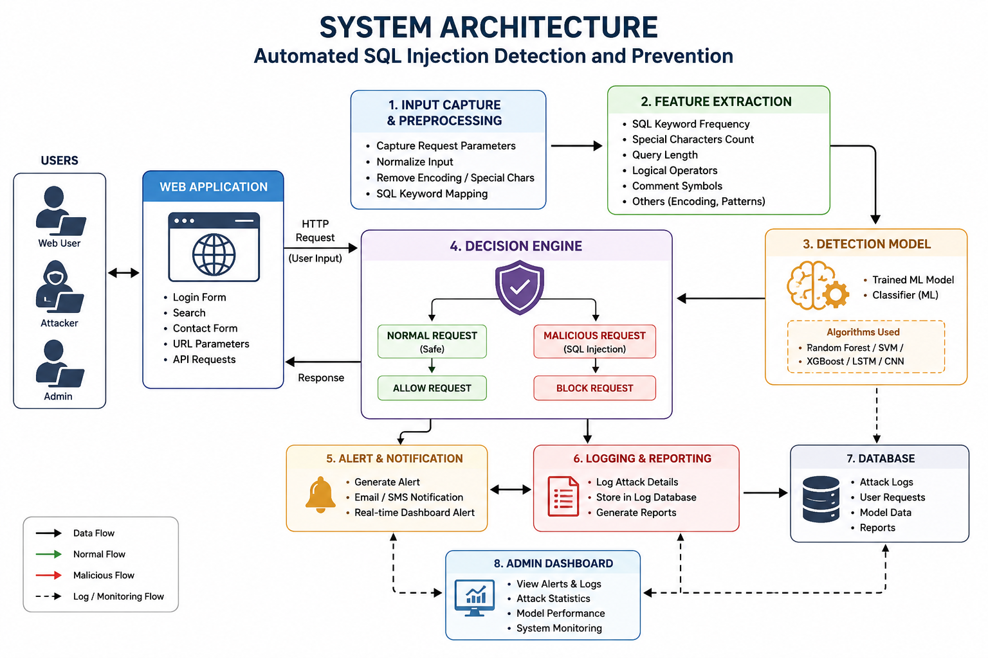

Slide 11


Sustainable Development Goal (SDG) Implementation
1. SDG 9 – Industry, Innovation and Infrastructure
Goal: Promote innovation and build secure and resilient digital infrastructure.
2. SDG 11 – Sustainable Cities and Communities
Goal: Support safer digital services and secure smart infrastructure.
3. SDG 16 – Peace, Justice and Strong Institutions
Goal: Promote secure, accountable and reliable digital systems.

Slide 12
PROPOSED METHODOLOGY AND ALGORITHM
Dataset ↓ Data Preprocessing ↓ SQL Query Normalization ↓ Feature Extraction ↓ Machine Learning Model ↓ Model Training ↓
Testing & Evaluation ↓ Real-Time Detection ↓ Attack Prevention

Slide 13
MODULE 1: DATASET COLLECTION & PREPARATION
Development Activities
Collect SQL Injection datasets
Collect normal SQL queries
Collect malicious SQL payloads
Remove duplicate records
Remove irrelevant data
Label normal and malicious samples
Organize dataset
Expected Output
Clean dataset
Labelled SQL queries
Balanced classes
Structured dataset
Training-ready data

Slide 14
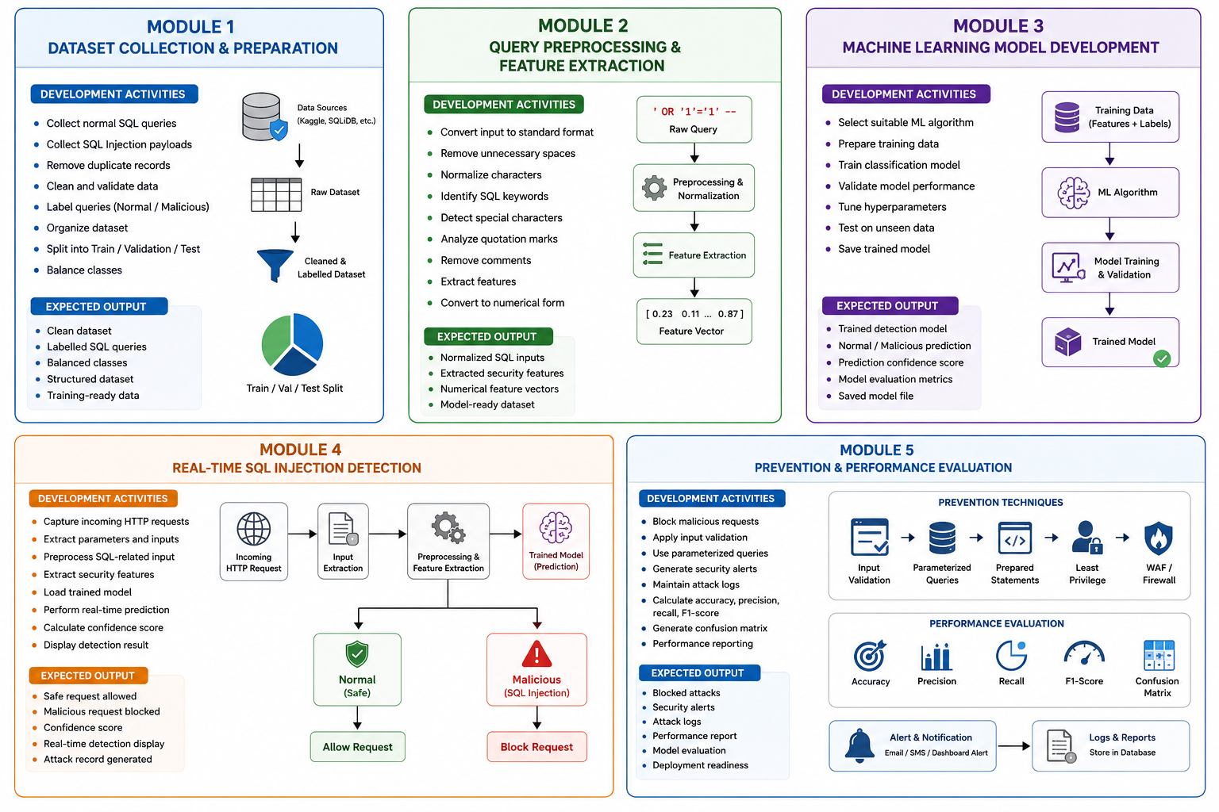
MODULE 1: DATASET COLLECTION & PREPARATION

Slide 15
MODULE 2: IMAGE PREPROCESSING & AUGMENTATION
Development Activities
Convert input into standard format
Remove unnecessary spaces
Normalize characters
Identify SQL keywords
Detect special characters
Analyze quotation marks
Extract operators
Identify SQL comments
Analyze query length
Generate numerical features
Expected Output
Clean query data
Normalized SQL input
Extracted security features
Model-ready dataset

Slide 16
MODULE 2: IMAGE PREPROCESSING & AUGMENTATION

Slide 17
MODULE 3: TRANSFER LEARNING MODEL DEVELOPMENT
Development Activities
Select detection algorithm
Prepare training data
Convert queries into numerical features
Train classification model
Validate model
Tune model parameters
Test unseen SQL queries
Save trained model
Expected Output
Trained detection model
Normal/Malicious classification
Prediction confidence
Validation metrics
Saved model

Slide 18
MODULE 3: TRANSFER LEARNING MODEL DEVELOPMENT

Slide 19
MODULE 4: REAL-TIME FIRE & SMOKE DETECTION
Development Activities
Integrate detection system with web application
Capture incoming requests
Analyze request parameters
Preprocess SQL-related input
Extract security features
Perform real-time prediction
Calculate confidence score
Identify malicious requests
Generate detection result
Expected Output
Safe request identification
SQL Injection identification
Confidence score
Real-time detection display
Attack record

Slide 20
MODULE 4: REAL-TIME FIRE & SMOKE DETECTION

Slide 21
MODULE 5: ALERT SYSTEM & PERFORMANCE EVALUATION
Development Activities
Block malicious requests
Apply input validation
Use parameterized queries
Generate security alerts
Maintain attack logs
Calculate accuracy
Calculate precision
Calculate recall
Calculate F1-score
Expected Output
Blocked attack
Security warning
Attack history
Performance report
Model evaluation
Deployment readiness

Slide 22
MODULE 5: ALERT SYSTEM & PERFORMANCE EVALUATION

Slide 23
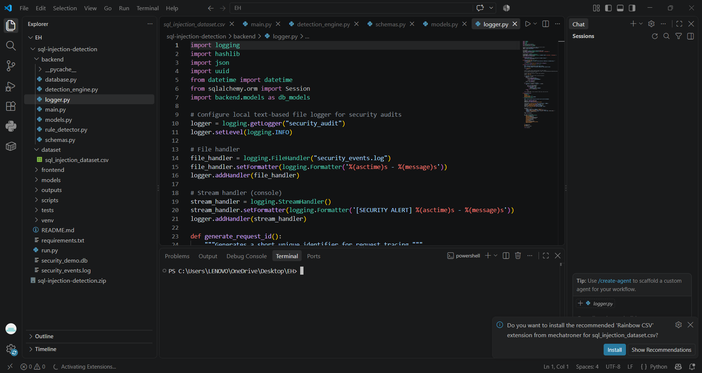
Code

Slide 24
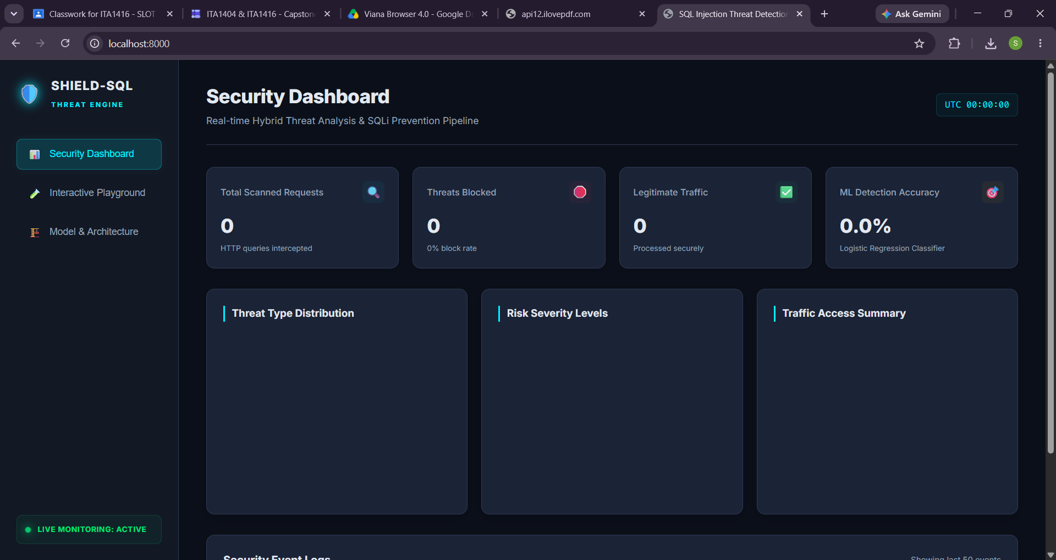
Demo page

Slide 25
FUTURE ENHANCEMENTS
Deep Learning-based SQL Injection detection
Real-time Web Application Firewall integration
API security monitoring
Cloud-based attack monitoring
Multi-application protection
Continuous model learning
Advanced anomaly detection
Automated threat intelligence integration
Dashboard for security administrators
Detection of previously unseen attack patterns

Slide 26
LIMITATIONS
Model performance depends on dataset quality
New attack techniques may not always be detected
Obfuscated payloads can be difficult to classify
False positives may occur
Complex SQL queries require careful analysis
Real-time processing requires computational resources
Poorly configured prevention mechanisms may affect legitimate requests
Continuous dataset and model updates are required

Slide 27
Conclusion
Problem → SQL Injection threatens web applications and databases
Solution → Automated machine-learning-based SQL Injection detection and prevention
Impact → Faster attack detection, reduced unauthorized access and improved database security
Project Value → Intelligent, automated and scalable web application security system
Final Workflow:
Detect → Classify → Block → Alert → Log

Slide 28
References
OWASP, SQL Injection, OWASP Web Application Security resources.
W. Halfond, J. Viegas, and A. Orso, A Classification of SQL-Injection Attacks and Countermeasures, IEEE.
M. Howard and D. LeBlanc, Writing Secure Code, Microsoft Press.
C. Anley, Advanced SQL Injection in SQL Server Applications, technical security research.
K. Scarfone and P. Mell, Guide to Intrusion Detection and Prevention Systems, NIST.
Research papers on Machine Learning-based Web Attack Detection.
Research papers on SQL Injection Detection using Deep Learning.

